Slide 1
System Software and Machine Architecture

Slide 2
Chapter Outline
Chapter 1 of Beck’s “System Software” book
1.1 Introduction
1.2 System Software and Machine Architecture
1.3 Simplified Instructional Computer (SIC)
  SIC Machine Architecture
  SIC/XE Machine Architecture
  SIC Programming Examples

Slide 3
System Software
System software consists of a variety of programs that support the operation of a computer, e.g.
  Text editor, compiler, loader or linker, debugger, macro processors, operating system, database management systems, software engineering tools, ….

Slide 4
System Software & Architecture
System software differs from application software in machine dependency
  System programs are intended to support the operation and use of the computer itself, rather than any particular application.
Thus, we must include real machines and real pieces of software in our study
Simplified Instructional Computer (SIC)
  SIC is a hypothetical computer that includes the hardware features most often found on real machines, while avoiding unusual or irrelevant complexities

Slide 5
Simplified Instructional Computer
Like many other products, SIC comes in two versions
  The standard model
  An XE version
    “extra equipments”, “extra expensive”
The two versions have been designed to be upward compatible

Slide 6
SIC Machine Architecture (1/5)
Memory
    Bytes – 8 bits
    Word – 3 bytes (24 bits)
    Byte addressable
    Words addressed by lowest byte
    32767 (2¹⁵) bytes of total memory
Registers
  Five registers, each is 24 bits in length
Mnemonic | Number | Special use
A | 0 | Accumulator
X | 1 | Index register
L | 2 | Linkage register
PC | 8 | Program counter
SW | 9 | Status word

Slide 7
SIC Machine Architecture (2/5)
Data formats
  24-bit integer representation in 2’s complement
  8-bit ASCII code for characters
  No floating-point on standard version of SIC
Instruction formats
  Standard version of SIC
  The flag bit x is used to indicate indexed-addressing mode
8 | 1 | 15
opcode | x | address

Slide 8
SIC Machine Architecture (3/5)
Addressing modes
  Two addressing modes
    Indicated by the x bit in the instruction
Mode | Indication | Target address calculation
Direct | x=0 | TA=address
Indexed | x=1 | TA=address+(X)
(X): the contents of register X

Slide 9
SIC Machine Architecture (4/5)
Instruction set:
  load and store: LDA, LDX, STA, STX, etc.
  integer arithmetic operations: ADD, SUB, MUL, DIV, etc.
    All arithmetic operations involve register A and a word in memory, with the result being left in the register
  comparison: COMP
    COMP compares the value in register A with a word in memory, this instruction sets a condition code CC to indicate the result
  conditional jump instructions: JLT, JEQ, JGT
    these instructions test the setting of CC and jump accordingly
  subroutine linkage: JSUB, RSUB
    JSUB jumps to the subroutine, placing the return address in register L
    RSUB returns by jumping to the address contained in register L

Slide 10
SIC Machine Architecture (5/5)
Input and output
  Performed by transferring 1 byte at a time to or from the rightmost 8 bits of register A
  Each device is assigned a unique 8-bit code, as an operand of I/O instructions
  The Test Device (TD) instruction tests whether the addressed device is ready to send or receive a byte of data
    Test Device (TD): < (ready), = (not ready)
      CC of < means device is ready
      CC of = means device is not ready
  Read Data (RD),
  Write Data (WD)

Slide 11
SIC Programming Example (Fig 1.2a)
Data movement
LDA FIVE load 5 into A
STA ALPHA store in ALPHA
LDCH CHARZ load ‘Z’ into A
STCH C1 store in C1
.
.
.
ALPHA RESW 1 reserve one word space
FIVE WORD 5 one word holding 5
CHARZ BYTE C’Z’ one-byte constant
C1 RESB 1 one-byte variable

Slide 12
SIC Programming Example (Fig 1.3a)
Arithmetic operations: BETA = ALPHA+INCR-1
LDA ALPHA
ADD INCR
SUB ONE
STA BETA
LDA GAMMA
ADD INCR
SUB ONE
STA DELTA
...
ONE WORD 1 one-word constant
ALPHA RESW 1 one-word variables
BETA RESW 1
GAMMA RESW 1
DELTA RESW 1
INCR RESW 1

Slide 13
SIC Programming Example (Fig 1.4a)
Looping and indexing: copy one string to another
LDX ZERO initialize index register to 0
MOVECH LDCH STR1,X load char from STR1 to reg A
STCH STR2,X
TIX ELEVEN add 1 to index, compare to 11
JLT MOVECH loop if “less than”
.
.
.
STR1 BYTE C’TEST STRING’
STR2 RESB 11
ZERO WORD 0
ELEVEN WORD 11

Slide 14
SIC Programming Example (Fig 1.5a)
LDA ZERO initialize index value to 0
STA INDEX
ADDLP LDX INDEX load index value to reg X
LDA ALPHA,X load word from ALPHA into reg A
ADD BETA,X
STA GAMMA,X store the result in a word in GAMMA
LDA INDEX
ADD THREE add 3 to index value
STA INDEX
COMP K300 compare new index value to 300
JLT ADDLP loop if less than 300
...
...
INDEX RESW 1
ALPHA RESW 100 array variables—100 words each
BETA RESW 100
GAMMA RESW 100
ZERO WORD 0 one-word constants
THREE WORD 3
K300 WORD 300

Slide 15
SIC Programming Example (Fig 1.6)
Input and output
INLOOP TD INDEV test input device
JEQ INLOOP loop until device is ready
RD INDEV read one byte into register A
STCH DATA
.
.
OUTLP TD OUTDEV test output device
JEQ OUTLP loop until device is ready
LDCH DATA
WD OUTDEV write one byte to output device
.
.
INDEV BYTE X’F1’ input device number
OUTDEV BYTE X’05’ output device number
DATA RESB 1

Slide 16
SIC/XE Machine Architecture (1/11)
Memory
  Bytes – 8 bits
  Word – 3 bytes (24 bits)
  Byte addressable
  Words addressed by lowest byte
  Maximum memory available on a SIC/XE system is 1 megabyte (2²⁰ bytes)
  An address (20 bits) cannot be fitted into a 15-bit field as in SIC Standard
  Must change instruction formats and addressing modes

Slide 17
SIC/XE Machine Architecture (2/11)
Registers
  5 registers of SIC + 4 Additional registers are provided by SIC/XE
Mnemonic | Number | Special use
B | 3 | Base register
S | 4 | General working register
T | 5 | General working register
F | 6 | Floating-point accumulator (48 bits)
Mnemonic | Number | Special use
A | 0 | Accumulator
X | 1 | Index register
L | 2 | Linkage register
PC | 8 | Program counter
SW | 9 | Status word

Slide 18
SIC/XE Machine Architecture (3/11)
Integers – 24 bit binary 2’s complement
Characters – 8 bit ASCII
There is a 48-bit floating-point data type
  fraction is a value between 0 and 1
  exponent is an unsigned binary number between 0 and 2047
zero is represented as all 0
1 | 11 | 36
s | exponent | fraction
f*2^{(e-1024)}

Slide 19
SIC/XE Machine Architecture (4/11)
Instruction formats
8
op
Format 1 (1 byte): RSUB
8 | 4 | 4
op | r1 | r2
Format 2 (2 bytes): COMPR A,S
6 | 1 | 1 | 1 | 1 | 1 | 1 | 12
op | n | i | x | b | p | e | disp
Format 3 (3 bytes):
LDA #3
i=1, rest 0
6 | 1 | 1 | 1 | 1 | 1 | 1 | 20
op | n | i | x | b | p | e | address
Format 4 (4 bytes)
Formats 1 and 2 do not reference memory at all
Bit e distinguishes between format 3 and 4

Slide 20
SIC/XE Machine Architecture (5/11)
Base Relative Addressing Mode
Program-Counter Relative Addressing Mode
 | n | i | x | b | p | e
opcode |  |  |  | 1 | 0 |  | disp
b=1, p=0, TA=(B)+disp (0≤disp ≤4095)
 | n | i | x | b | p | e
opcode |  |  |  | 0 | 1 |  | disp
b=0, p=1, TA=(PC)+disp (-2048≤disp ≤2047)

Slide 21
SIC/XE Machine Architecture (6/11)
Direct Addressing Mode
 | n | i | x | b | p | e
opcode |  |  |  | 0 | 0 |  | disp
b=0, p=0, TA=disp (0≤disp ≤4095)
 | n | i | x | b | p | e
opcode |  |  | 1 | 0 | 0 |  | disp
b=0, p=0, TA=(X)+disp
(with index addressing mode)

Slide 22
SIC/XE Machine Architecture (7/11)
Immediate Addressing Mode
Indirect Addressing Mode
 | n | i | x | b | p | e
opcode | 0 | 1 | 0 |  |  |  | disp
n=0, i=1, x=0, operand=disp
 | n | i | x | b | p | e
opcode | 1 | 0 | 0 |  |  |  | disp
n=1, i=0, x=0, TA=(disp)

Slide 23
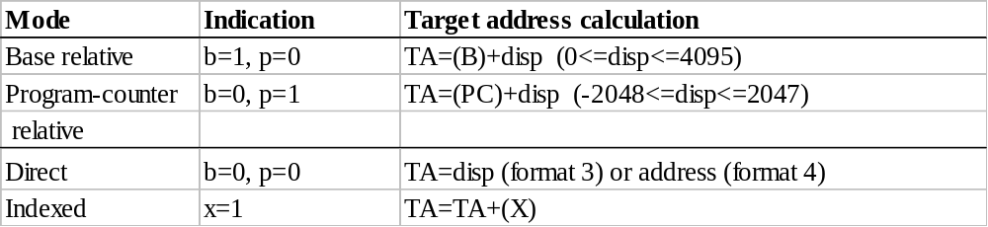
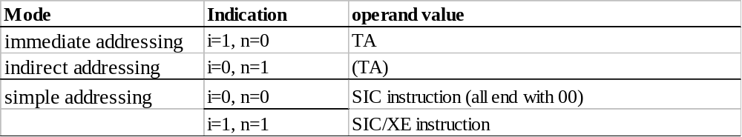
SIC/XE Machine Architecture
Addressing Modes
  How the target address is used?
  Note: Indexing cannot be used with immediate or indirect addressing modes

Slide 24
SIC/XE Machine Architecture (11/11)
Load and Store Registers
  LDA, LDX, STA, STX, LDB, STB, RMO
Integer Arithmetic (all involve register A)
  Add, SUB, MUL, DIV, ADDF, SUBF, MULF, DIVF, ADDR, SUBR, MULR, DIVR
Compare
  COMP – compares A with a word in memory
  Sets the CC in the SW
Jump instructions
  JLT, JEQ, JGT – based on the CC as set by COMP
Subroutine Linkage
  JSUB – jumps to subroutine, places return address in L
  RSUB – returns, using the address in L

Slide 25
SIC/XE Machine Architecture (11/11)
  Floating-point arithmetic operations
    ADDF, SUBF, MULF, DIVF
  Register move: RMO
  Register-to-register arithmetic operations
    ADDR, SUBR, MULR, DIVR
  Supervisor call: SVC
Input and output:
  I/O channels to perform I/O while CPU is executing other instructions: SIO, TIO, HIO

Slide 26
SIC/XE Programming Example (Fig 1.2b)
SIC version
SIC/XE version
LDA FIVE
STA ALPHA
LDCH CHARZ
STCH C1
.
.
.
ALPHA RESW 1
FIVE WORD 5
CHARZ BYTE C’Z’
C1 RESB 1
LDA #5
STA ALPHA
LDCH #90
STCH C1
.
.
.
ALPHA RESW 1
C1 RESB 1

Slide 27
SIC/XE Programming Example (Fig 1.3b)
LDS INCR
LDA ALPHA BETA=ALPHA+INCR-1
ADDR S,A
SUB #1
STA BETA
LDA GAMMA DELTA=GAMMA+INCR-1
ADDR S,A
SUB #1
STA DELTA
...
...
ALPHA RESW 1 one-word variables
BETA RESW 1
GAMMA RESW 1
DELTA RESW 1
INCR RESW 1

Slide 28
SIC/XE Programming Example (Fig 1.4b)
Looping and indexing: copy one string to another
LDT #11 initialize register T to 11
LDX #0 initialize index register to 0
MOVECH LDCH STR1,X load char from STR1 to reg A
STCH STR2,X store char into STR2
TIXR T add 1 to index, compare to 11
JLT MOVECH loop if “less than” 11
.
.
.
STR1 BYTE C’TEST STRING’
STR2 RESB 11

Slide 29
SIC/XE Programming Example (Fig 1.5b)
LDS #3
LDT #300
LDX #0
ADDLP LDA ALPHA,X load from ALPHA to reg A
ADD BETA,X
STA GAMMA,X store in a word in GAMMA
ADDR S,X add 3 to index value
COMPR X,T compare to 300
JLT ADDLP loop if less than 300
...
...
ALPHA RESW 100 array variables—100 words each
BETA RESW 100
GAMMA RESW 100

Slide 30
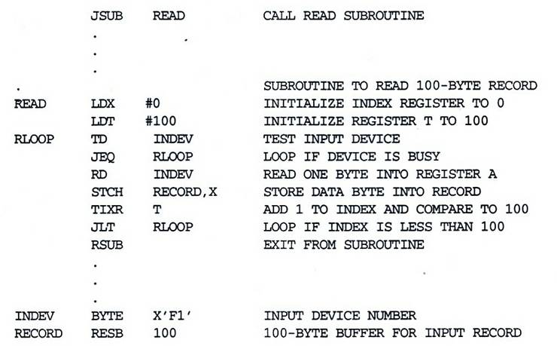
SIC/XE Programming Example (Fig 1.7b)

